Slide 1
Birthday Problem
You will design a circuit that will display your birthday one digit at a time. (mmddyy)
You will switch from one digit to the next by assigning a number to each one of the digits in your birthday and using binary conversion to create the inputs necessary to create that assigned number in binary.
EX:
0 → 000 → m = 1
1 → 001 → m = 2
2 → 010 → d = 2
.
.
etc.
When your inputs are set to 0, your first digit will be displayed.
When your inputs are set to 1, your second digit will be displayed.
…and so on.

Slide 2
Don’t Care
There will be times when a certain combination of inputs will not occur during normal operation. Rather than placing a 1 or 0 for these outputs, we place an X to signify that we “don’t care” about this particular outcome.

Slide 3
Don’t Care Example
You need to create a circuit that will display the 4 cardinal directions to indicate if the user should change directions. You assign 0 – No change, 1 – North, 2 – South, 3 – East, 4 – West.
These are the only 5 inputs you care about,
but you need 3 inputs to make a 4 in binary.
This means there’s going to be 8 input
combinations, 3 of which you don’t care about.
This is what your truth table should look like.
# | A | B | C | Out
0 | 0 | 0 | 0 | NC
1 | 0 | 0 | 1 | N
2 | 0 | 1 | 0 | S
3 | 0 | 1 | 1 | E
4 | 1 | 0 | 0 | W
5 | 1 | 0 | 1 | X
6 | 1 | 1 | 0 | X
7 | 1 | 1 | 1 | X

Slide 4
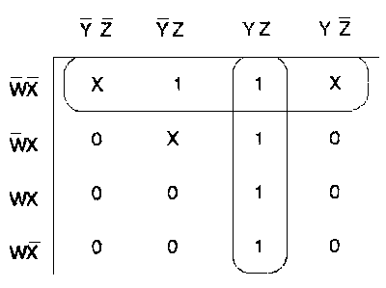
Don’t Cares and Karnaugh Maps
When you make a Karnaugh map with Don’t Cares they act as a “wild card.” They can represent either a 1 or a 0 depending on what is most convenient for you.
Ex:

Slide 5
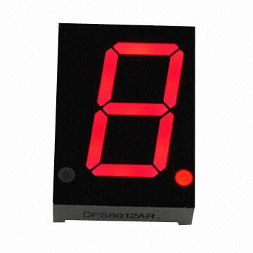
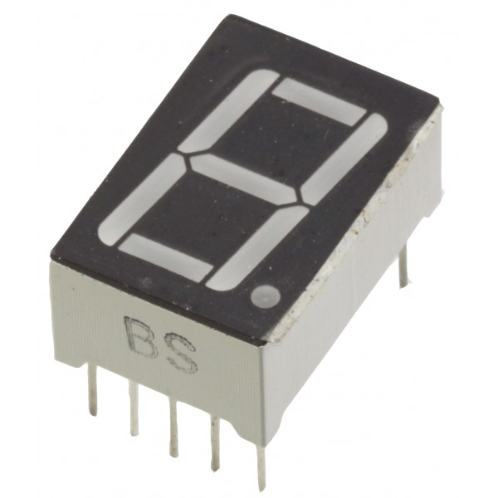
7-Segment Display
Used to display characters
Light up different LED segments to create the characters

Slide 6
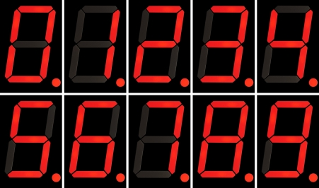
Displaying Numbers 0-9

Slide 7
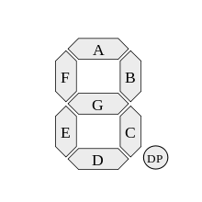
Naming the Segments
Each segment is named using the letters A-F
The decimal point is shorted to DP on design schematics

Slide 8
Common Anode
Our 7-segment LEDs are common anode
Share the same power source, NOT the same ground
To turn ON an LED, you need to shift a 0
To turn OFF an LED, you need to shift a 1

Slide 9

Pin Diagram (for Logisim)
G F A B
Note that the Logisim
diagram does not require you
to power this element but you will
need to power it IRL.
E D C DP

Slide 10
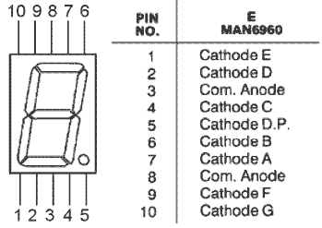
Pin Diagram (for circuit)

Slide 11
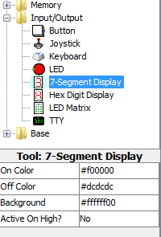
Birthday Problem Instructions
Complete the Birthday Problem Worksheet on the HUB
Next, build your schematic using Logisim. You should have three inputs and their complements (NOTs) and 7 different outputs. Each output will be connected to its corresponding input on the seven segment display. Make sure you change it to “Active On High? No.”

